Slide 1
Overwatch Sentiment
Sine Gov
Springboard Capstone
1/19/2018

Slide 2
Business Challenge
Overwatch is a product that needs to continually evolve to keep players happy. The game changes through new content in the form of heroes or maps and changes to balance due to new heroes or bug fixes.
The community reacts in various ways, such as being negative in game or not playing. Both of these led to a financial loss and more importantly a loss of trust in our players. We need to constantly monitor and address what players are saying in public forums to stymie these issues, however there is a high volume of comments.
Notes:
Overwatch is a product that needs to continually evolve to keep players happy. The game changes through new content in the form of heroes or maps and changes to balance due to new heroes or bug fixes.
The community reacts in various ways, such as being negative in game or not playing. Both of these led to a financial loss and more importantly a loss of trust in our players. We need to constantly monitor and address what players are saying in public forums to stymie these issues, however there is a high volume of comments.

Slide 3
Solution
We need an efficient way to quickly get an understanding of the community’s sentiment and to remain as objective as possible.
Additionally we need to be able to address the rising number of customer service reports regarding toxic language in a more efficient manner.
We can address these problems through analyzing comments made on social media and creating a prototype algorithm to detect negative sentiment using the comments scrapped from social media.
Notes:
We need an efficient way to quickly get an understanding of the community’s sentiment and to remain as objective as possible.
Additionally we need to be able to address the rising number of customer service reports regarding toxic language in a more efficient manner.
We can address these problems through analyzing comments made on social media and creating a prototype algorithm to detect negative sentiment using the comments scrapped from social media.

Slide 4
Approach
Collect text comments from Twitter, Reddit, and the Official Overwatch Forums.
Run a sentiment analyzer against comments.
Explore the results of the sentiment analysis to gain high level overview of the community’s feeling of Overwatch.
Use the sentiment data to create an algorithm that will predict whether text will be positive or negative in nature.
Provide algorithm and suggested next steps.
Notes:
Collect text comments from Twitter, Reddit, and the Official Overwatch Forums.
Run a sentiment analyzer against comments.
Explore the results of the sentiment analysis to gain high level overview of the community’s feeling of Overwatch.
Use the sentiment data to create an algorithm that will predict whether text will be positive or negative in nature.
Provide algorithm and suggested next steps.

Slide 5
Data
Data was scrapped from the /r/Overwatch subreddit and the Overwatch Forums General board using custom scripts written in R.
Twitter data was scrapped using the TwitteR library.
Text data was cleaned in preparation of sentiment analysis.
All data was gathered on December 22, 2017 and may contain data from a few days before this date.
Notes:
Data was scrapped from the /r/Overwatch subreddit and the Overwatch Forums General board using custom scripts written in R.
Twitter data was scrapped using the TwitteR library.
Text data was cleaned in preparation of sentiment analysis.
All data was gathered on December 22, 2017 and may contain data from a few days before this date.

Slide 6
Sentiment Analysis Method
Sentences are scored in the following manner:
“I'd really love this, actually. It would be a great thing to have.”
“Yup genji useless, genji mains beware”
Notes:
Here are two examples of sentences found on reddit or the Overwatch forums.

Slide 7
Sentiment Analysis Method
Sentences are scored in the following manner:
“I'd really love this, actually. It would be a great thing to have.”
“Yup genji useless, genji mains beware”
1
1
-1
-1
Notes:
The sentiment analysis script will drop any irrelevant words, or stop words, and score the words that exist in the lexicon.

Slide 8



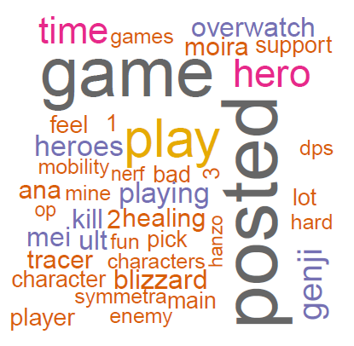
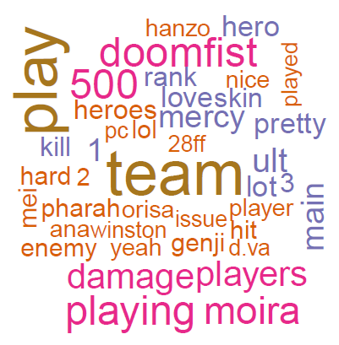
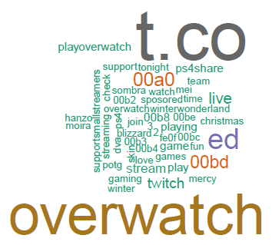
Most Used Words
Word clouds for each community
Notes:
The word cloud for the Overwatch Forums shows that the community is talking about genji, moira, hero, support. Posted may imply that further refinement of the cleaning script is required.
The word cloud for Reddit shows doomfist, team, 500, playing, moira, and damage among some other hero names.
The word cloud for Twitter shows t.co which may be part of a URL. Overwatch and several terms related to streaming such as ps4share, stream, watch, sponsed, time, and twitch.

Slide 9

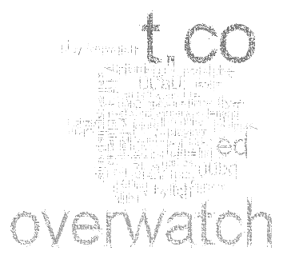
Most Used Words
Word clouds for each community
Notes:
Since twitter seems to have data regarding streaming and links this dataset was removed from further analysis. The word clouds we are left with seem to have data we are interested in which means we are on the right track. Not all heroes were mentioned in these word clouds and further research into what is being discussed about these heroes may yield interesting results. From here, we can run sentiment analysis and we may be able to draw conclusions based on the results.

Slide 10
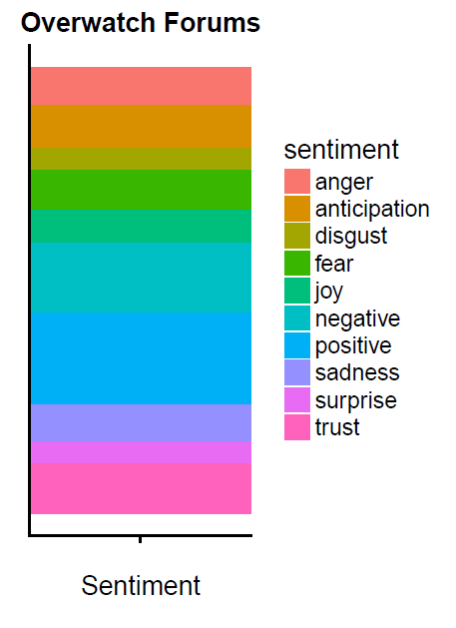
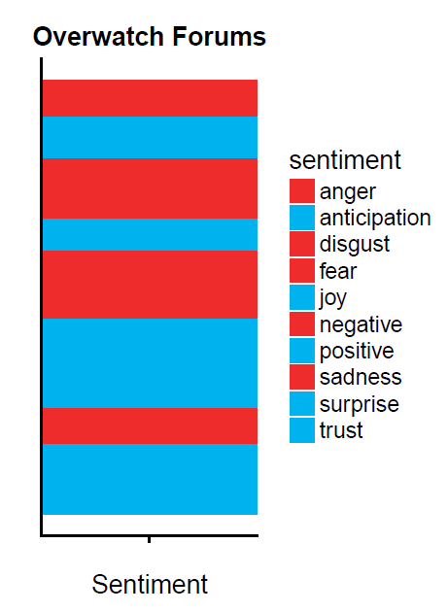
Sentiment
Notes:
Here we analyze the breakdown of 10 emotions for the Overwatch forums. We can see there is a great deal of positive sentiment, however there is a great deal of negative sentiment. If we group the good and bad sentiments together, we can see that the community is nearly split on sentiment; almost half is communicating negative sentiment and the bigger half is communicating positive sentiment.

Slide 11
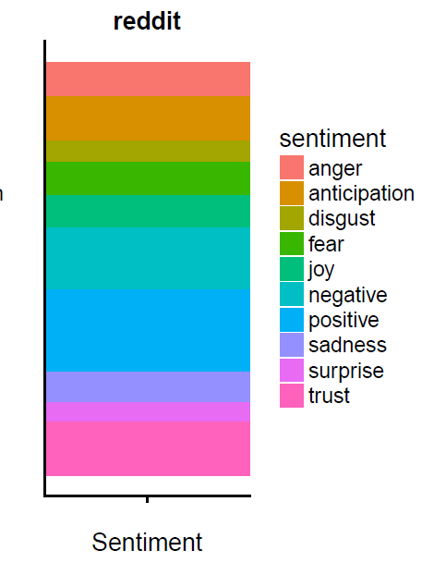
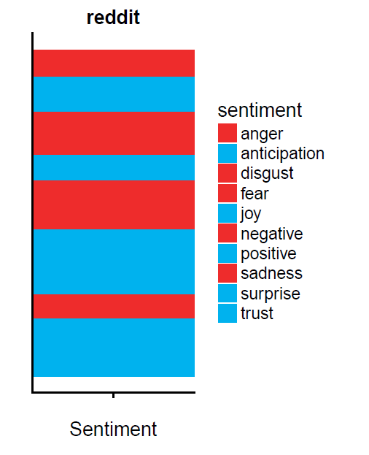
Sentiment
Notes:
Here are the results for reddit and they look rather similar to the Overwatch forums. This similarity may be due to users visiting both sites. Additionally it implies that there is a consensus in sentiment which may be helpful in addressing the concerns of the community.

Slide 12
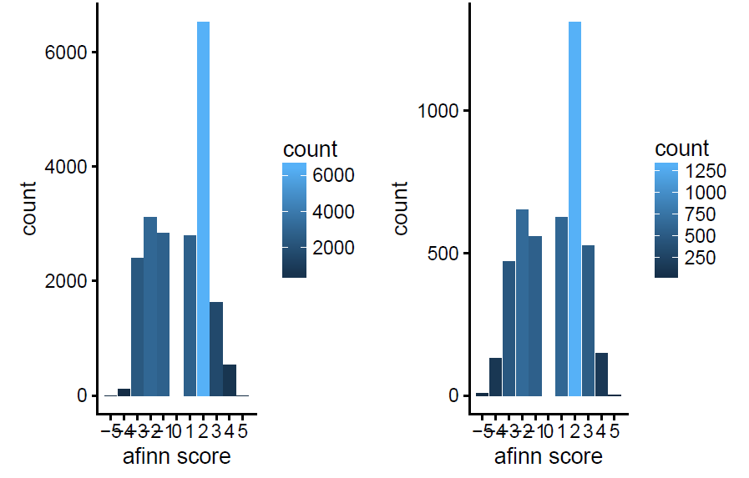
Sentiment
Notes:
Looking at sentiment on a 10 point scale, we see the results again are similar. It may be a bit more clear here in that nearly half the sentiment is negative.

Slide 13
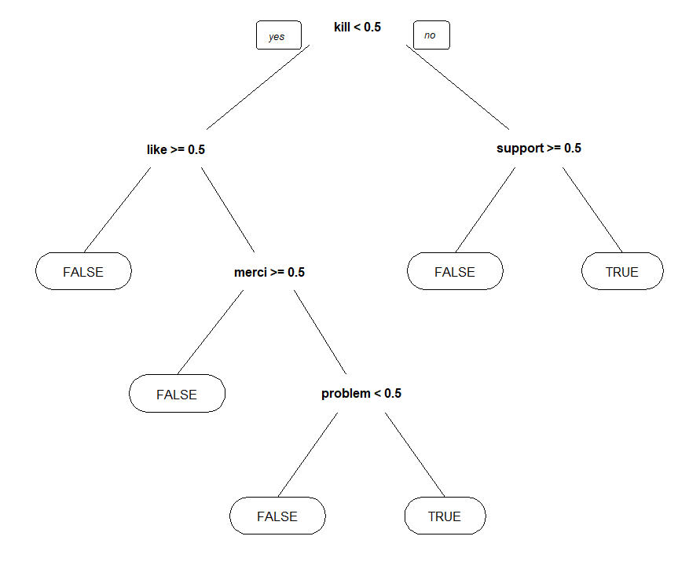
Modeling Negative Sentiment Method
Classification and Regression Trees
Word does not exists
Word Exists
Notes:
From this sentiment data, we can begin to model an algorithm that will automatically detect negative sentiment. This is an example of the classification and regression trees method. The computer will model some of the words seen in a negative sentence. Depending on which words exist in the sentence, it will evaluate to TRUE (negative) or FALSE (positive). Going left at a decision point means that the word exists, and going right means it does not exist.

Slide 14
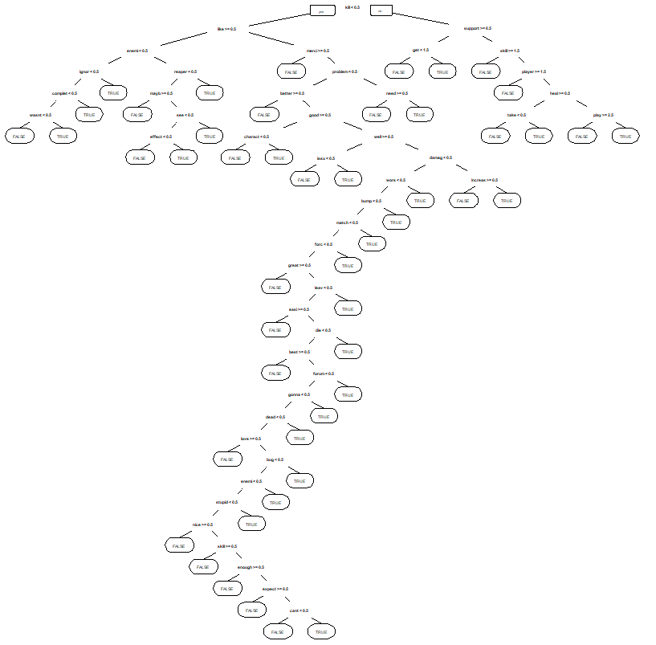
Modeling Negative Sentiment Method
Classification and Regression Trees
Notes:
Here’s an example of a model with a higher accuracy. It may be difficult to see the actual words, but the idea is that these models can be complex in determining negativity.

Slide 15
Negative Sentiment Predictor Results
 | Predicted: FALSE | Predicted: TRUE
Actual: FALSE | 537 | 54
Actual: TRUE | 107 | 230
Accuracy of Best Model = (537+230)/(537+230+54+107)
83%
Notes:
Here are the results for the best model developed using this method. In this table, we see how the model fared with data it has never seen. This model can predict with about 83% accuracy negative sentiment.

Slide 16
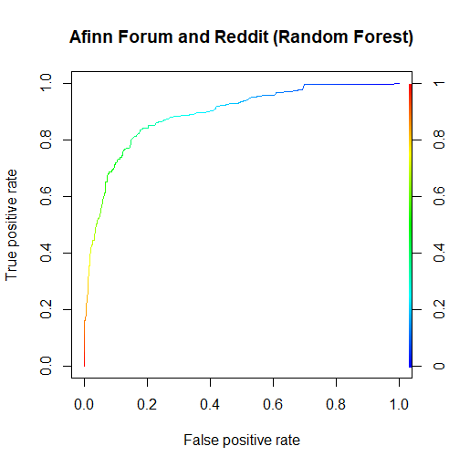
Negative Sentiment Predictor Results
With an 83% accuracy, we have a false positive rate of about 2%
We have a choice with making the model more or less accurate at the cost of incorrectly identifying positive sentiment as negative

Slide 17
Flaws of Negative Sentiment Predictor
This algorithm does not use actual customer service reports, which may provide different results. Additionally this algorithm does not detect sarcasm nor does it capture the language of Overwatch. Words like ‘Kill’ or ‘Mercy’ which can be seen as negative or positive respectively are normally neutral in the context in Overwatch.

Slide 18
Summary
The Overwatch community seems to enjoy a high amount of positivity, but there is a great deal of negative sentiment.
Using machine learning, an algorithm can be built that can help detect negative sentiment automatically.
Built correctly we can employ it to help us save customer service hours.

Slide 19
Next Steps
To improve the algorithm the following should be done:
Create an Overwatch lexicon to ensure correct sentiment.
Obtain customer service report data and train a new model.
Integrate the new algorithm to automatically detect negative language or sentiment.
Monitor reddit and the Overwatch forums; collect text data daily to help predict the community reaction to changes.
Correlate the text data to changes made for the game; use this to help evaluate impact of changes.

